Slide 1


Adoption Prediction
Yen Le
Mengting Wang

Slide 2
Table of Contents
Introduction
Selection of Data
Methods
Result
Discussion
Summary

Slide 3
Introduction
Kaggle Competition (ended)
Predict the speed at which a pet is adopted based on the pet’s listing on PetFinder.my
Guide shelters and resecures who posted the animal information
If the pet adoption speed is well-predicted
more efficient resource allocation
Improve the overall adoption performance
Reduce costs of sheltering and fostering

Slide 4

Selection of Data
6 sources of data + Images
Metadata + Sentiment Data
Train.csv:
14,993 samples
24 features
Categorical
Numerical
Drop
Type
Gender
Maturity Size
Fur Length
Vaccinated
Dewormed
Sterilized
Health
Breed1
Color1
Age
Fee
Video Amount
Photo Amount
Quantity
PetID
RescuerID
Name
Description
Color2
Color3
Breed2

Slide 5
Methods
Tools:
Numpy, Pandas, Matplotlib, and Seaborn for data analysis and visualization
Scikit-learn for inference
Streamlit for web app design
Github for web app deployment and version control
VS Code as IDE
Anaconda for Juypter Notebook
Inference methods used with Scikit:
Models: Naive Bayes, KNeighborsClassifier, Logistic Regression, RandomForestClassifier
Features: OneHotEncoder/ColumnTransformer, StandardScaler, Simpleimputer for missing values
GridSearchCV for hyperparameter tunning

Slide 6
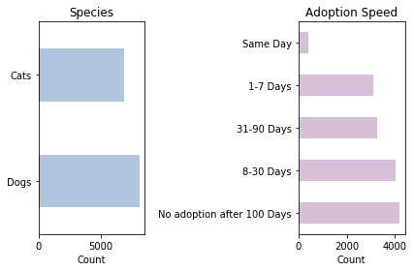
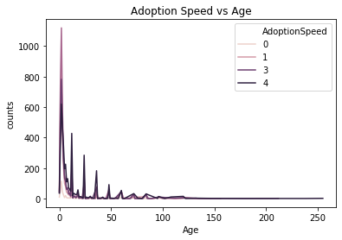
Data Visualization
Notes:
We did some simple visualization with matplotlib and seaborn. We can see that there are more dogs than cats in the dataset. It is rare that pets are adopted the same day as listing. They are adopted in 8-30 days or more than 100 days. Younger pets tend to be adopted much faster than older pets

Slide 7
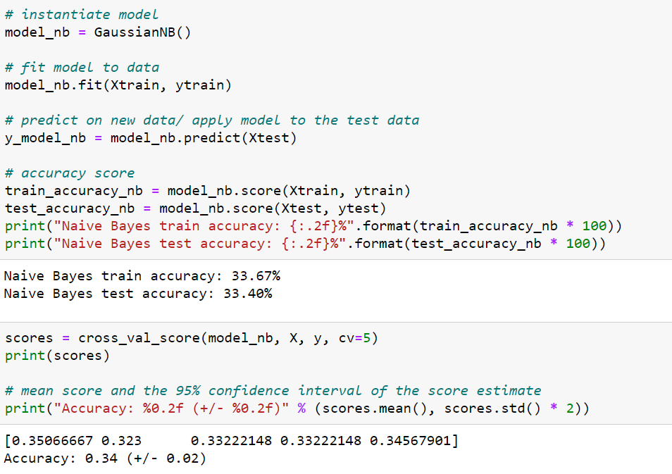

Model 1 – Naïve Bayes
Bad Performance

Slide 8
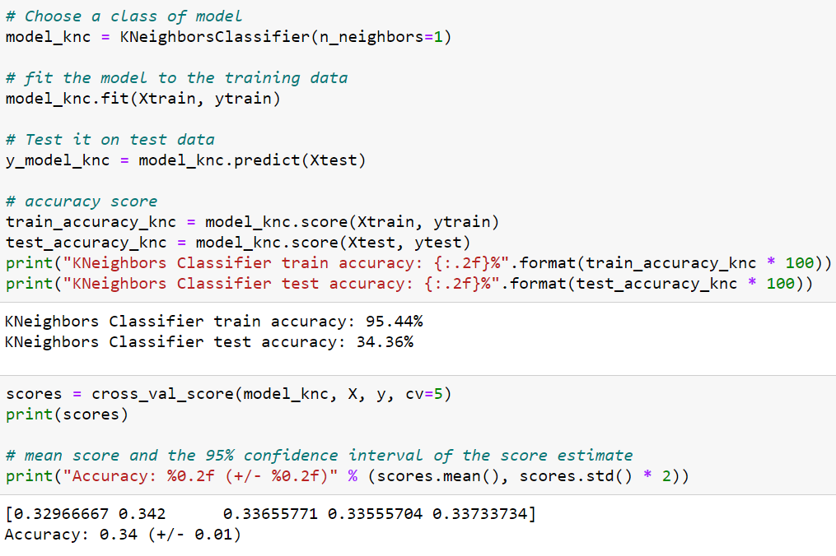
Model 2 – KNeighborsClassifier
High train accuracy
Low test accuracy

Slide 9
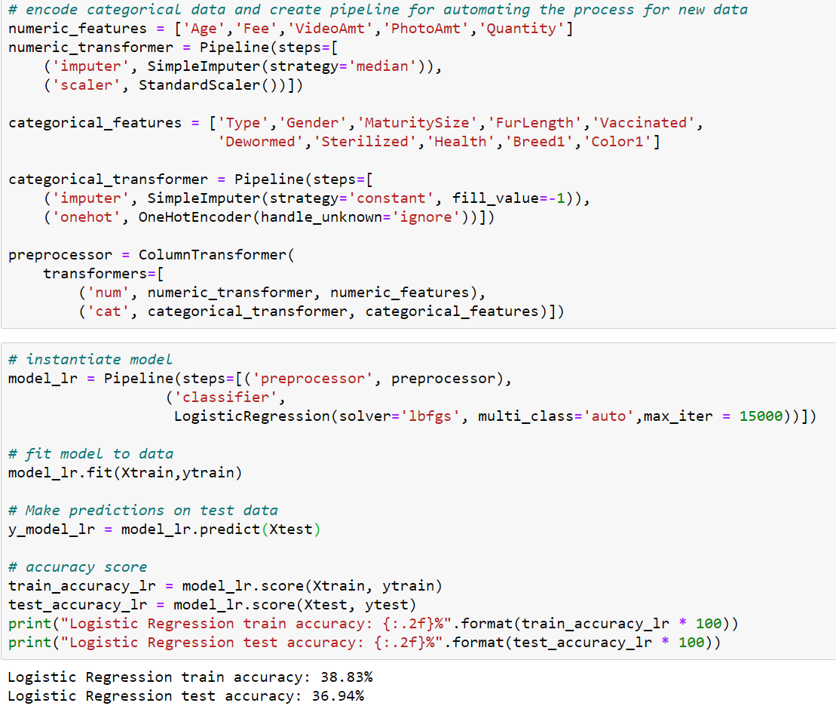
Model 3 – Logistic Regression
5% accuracy improvement

Slide 10
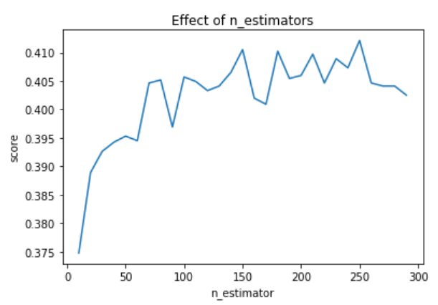

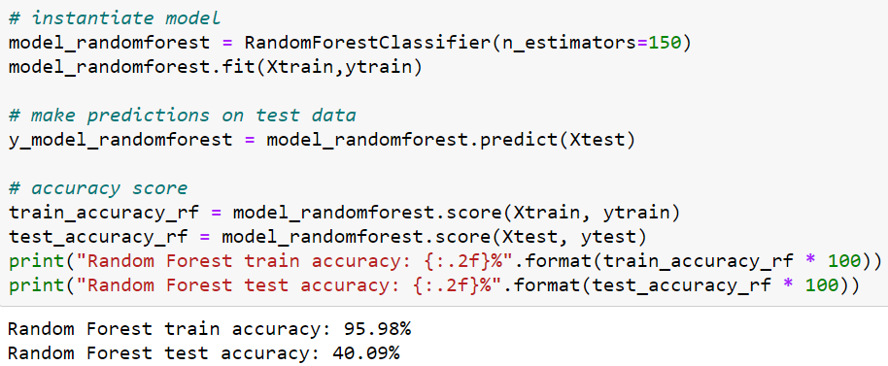
Model 4 – Random Forest Classifier

Slide 11

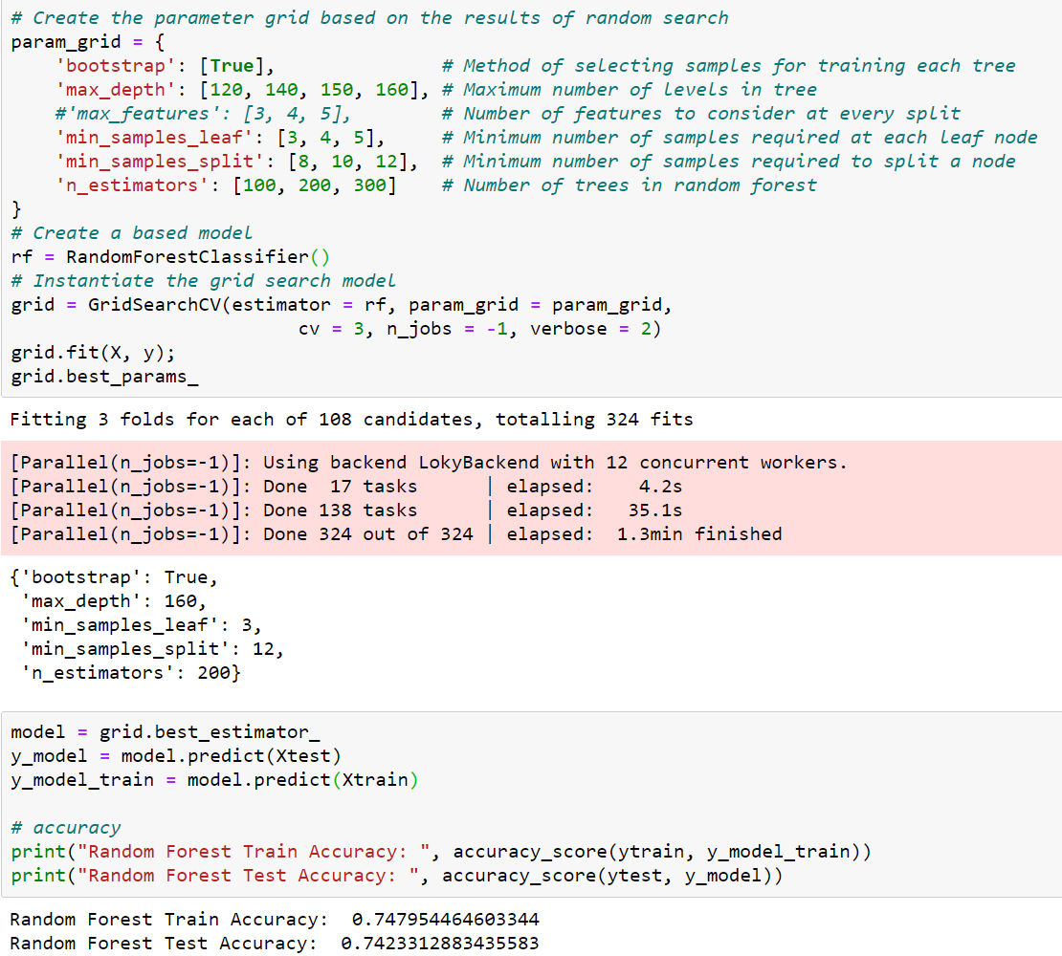
Random Forest Classifier GridSearchCV

Slide 12
Discussion
Model | Train Accuracy | Test Accuracy | Quadratic Weighted Kappa Score
Kneighbors Classifier | 95.44% | 34.36% | 0.23729
Naive Bayes | 33.67% | 33.40% | 0.21658
Logistic Regression | 38.83% | 36.94% | 0.25357
RandomForest Classifier | 74.79% | 74.23% | 0.60556
Issue: did not incorporate profile images or the animal description (text data)
Popular algorithms: LightGBM, Naural Networks, and XGBoost

Slide 13
Result
Online
How would you like to predict ?
a single adoption speed
Batch
many instances at once.

Slide 14


Demonstration
Heroku
https://pet-adoption-speed-prediction.herokuapp.com/

Slide 15
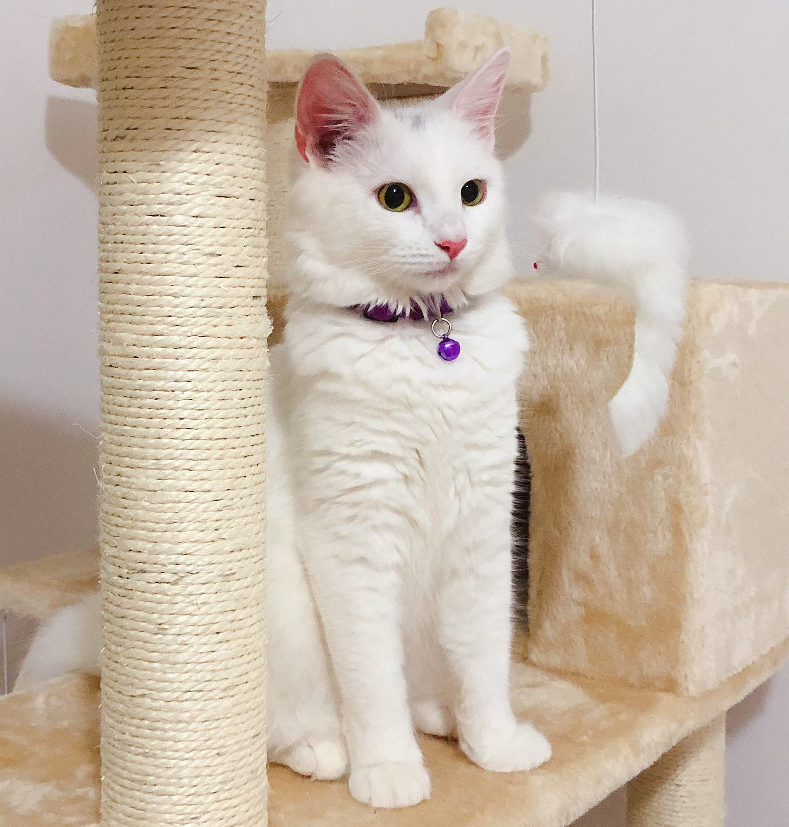
Summary
Supervised classification model
16 features
model's testing accuracy remains around 70%.

Slide 16
Next: App Demo
(and vote for us!!)

